Slide 1
Rapid Diagnostic Focus Group Discussions

Slide 2
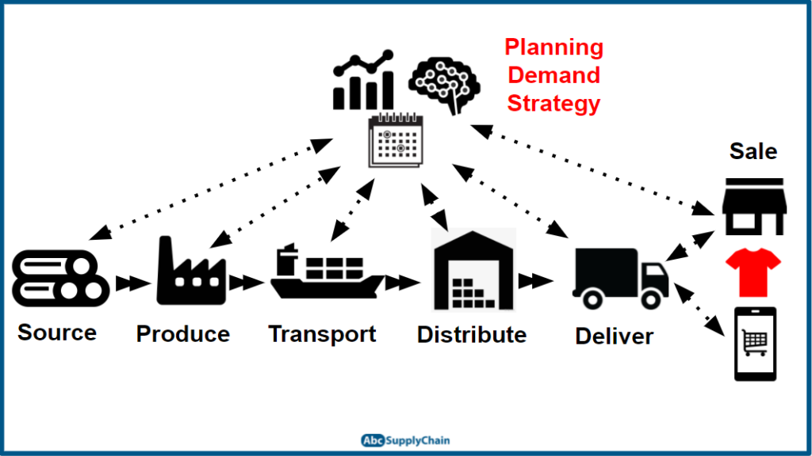

Slide 3
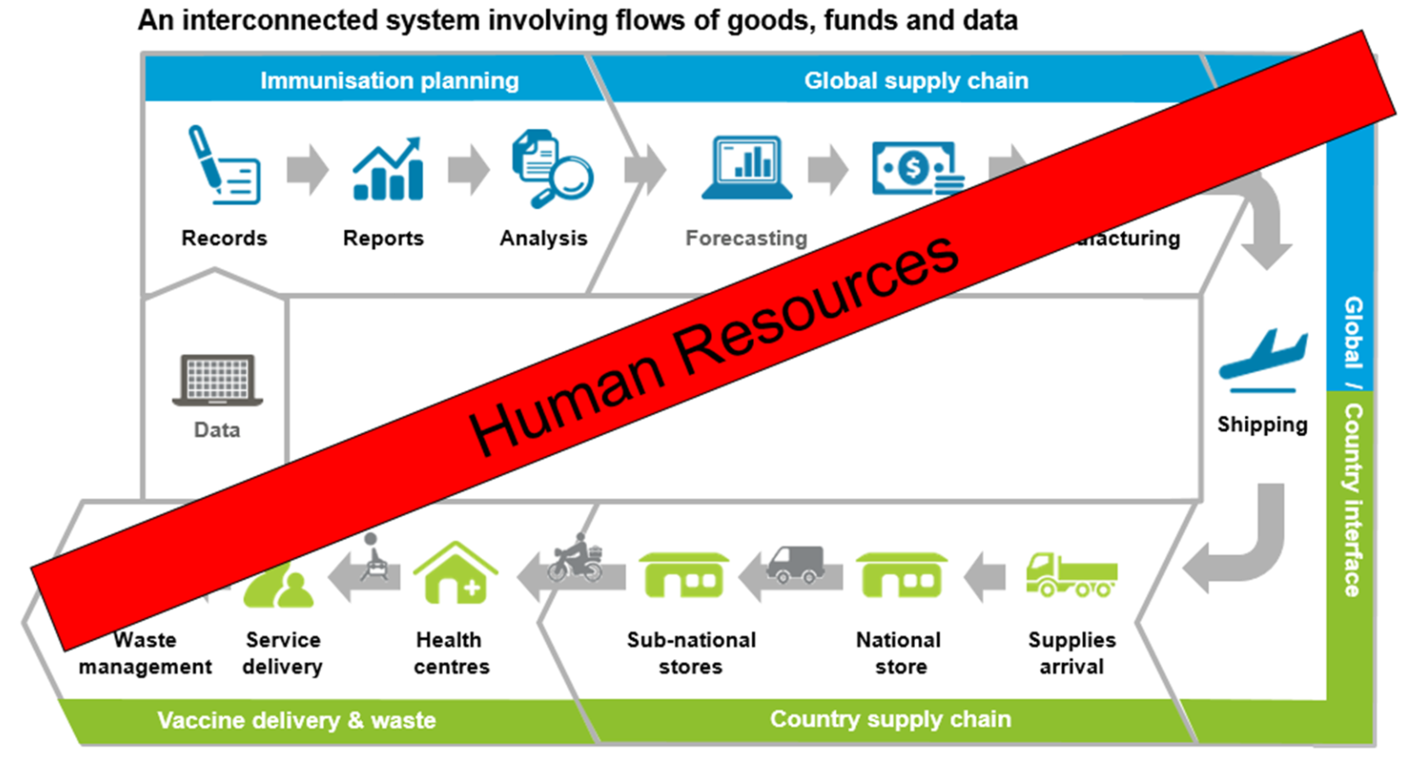

Slide 4
Supply chain professionals
The supply chain requires many professionals. Who are these health workers?
Procurement Specialists
Pharmacists/Pharmacy Assistants
Nurses
Demand and Supply Planners
Contracts Specialists
Performance Monitoring
Finance and Administration
Logisticians
Supply chain managers
Cold Chain managers
Data managers
Warehouse and distribution personnel
Drivers
Pickers and packers
And many more

Slide 5
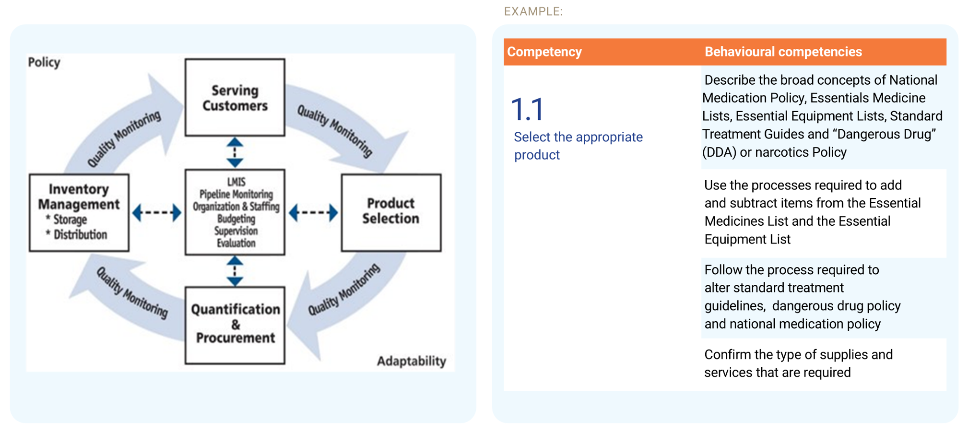
SCM competencies
Competencies are knowledge, skills and abilities needed for your position/role

Slide 6
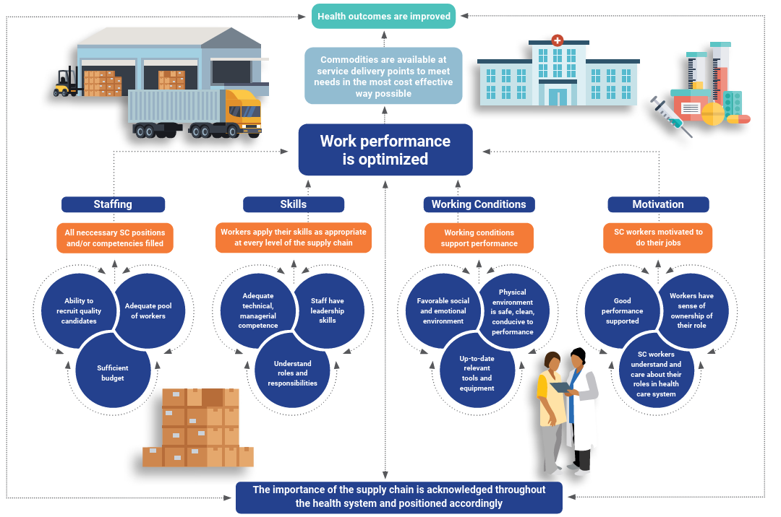
Notes:
The Theory of Change (ToC) presupposes that if four critical supply chain human resource pathways—staffing, skills, working conditions and motivation—are improved, then work performance is optimized, which then contributes to improved commodity availability at service delivery points in the most cost-effective way possible and will ultimately improve overall health outcomes.
The diagram shows the ToC foundational principle with its four pathways.
The HR4SCM ToC describes the steps needed to achieve long-term goals.
It identifies the connections between activities and outcomes across four pathways: staffing, skills, working conditions, and motivation.
This approach helps prioritize workforce interventions that strengthen health supply chains.

Slide 7
WORKING CONDITIONS
Favorable social and emotional environment

Slide 8
Social and emotional environment
1. Do equal employment opportunity policies exist (equal employment opportunities discuss fair treatment in employment, promotion, training, and other personnel actions without regard to race, color, religion, sex, age, national origin, and physical or mental disability)?

Slide 9
Social and emotional environment
2. Are there environmental and occupational safety policies?
If so, is compliance monitored?

Slide 10
Social and emotional environment
3. Do harassment policies exist, especially those towards women?
If so, is compliance monitored regularly?

Slide 11
Social and emotional environment
4. Is there anti-harassment training for supervisors?
Are there regular trainings for supply chain supervisors?
If trainings happen, is anti-harassment discussed?

Slide 12
Social and emotional environment
5. Is an employee satisfaction survey conducted each year?
Are employee satisfaction surveys conducted when staff leaves the service?

Slide 13
WORKING CONDITIONS
Physical environment is safe, clean and conducive to performance

Slide 14
Physical environment
1. Does you have a list of required characteristics for a safe and conducive environment and the list is accessible by all staff?
Do documented guidelines for a safe and conducive work environment exist?
If they exist, are they clearly visualized in your work environment?

Slide 15
Physical environment
2. Do your training materials have content on establishing a safe and clean work environment?
Are they available to all staff?
Is there training on creating a safe and clean work environment?

Slide 16
Physical environment
3. Is funding (from regular budget) allocated for maintenance of work environment sufficient?
Is it allocated, but not sufficient?
Is it sufficient and evidenced by physical inspection?

Slide 17
Physical environment
4. Do staff feel that their physical environment is safe, clean and conducive to performance?

Slide 18
Physical environment
5. Does you have a system in place to capture and address workplace safety incidents?
Are incidents being monitored, reported and addressed?

Slide 19
WORKING CONDITIONS
Supply chain workers have up to date and relevant tools and equipment to perform

Slide 20
Tools and equipment
1. Is there a list of necessary tools and equipment?
If so, is it available for all staff?

Slide 21
Tools and equipment
2. Do staff feel that they have access to necessary tools and equipment?

Slide 22
Tools and equipment
3. Are the tools and equipment in satisfactory condition?
Are tools complete?
Are they replaced when necessary?

Slide 23
Tools and equipment
4. Do training material exist on how to use tools and equipment?

Slide 24
Tools and equipment
5. Is sufficient funding allocated tor the procurement of tools and equipment?
Does the funding come from partners or government?

Slide 25
SKILLS
Supply chain workers demonstrate adequate technical and managerial competencies

Slide 26
Technical competencies
1. Do you have a documented list of critical supply chain management competencies for all supply chain services?
Are the competencies (skills, knowledge and abilities required to undertake supply chain tasks) documented?
Are managers aware of them?

Slide 27
Technical competencies
2. Do supply chain management roles have competencies assigned to them?
Is there a list of supply chain management competencies?
Are the supply chain management competencies linked to roles?

Slide 28
Technical competencies
3. Does a competency review process exist?
Is there a regular review of competencies?
When did the last one occur?

Slide 29
Technical competencies
4. Is a Training Needs Assessment (TNA) carried out at least once every 5 years?
If it has been done, was any training implemented as a result?

Slide 30
Technical competencies
5. Is there strong collaboration with local educational institutions on supply chain management?

Slide 31
SKILLS
Supply chain workers have leadership skills within their sphere of operations

Slide 32
Leadership skills
1. Are there opportunities for leadership training for supply chain workers?
Is the importance of leadership recognized?
Are there any plans for training?

Slide 33
Leadership skills
2. Are aspiring supply chain staff given the opportunity to take on more responsibilities?
Are supply chain staff ever given additional tasks?

Slide 34
Leadership skills
3. Is there a structured mentoring supervision program in place for all supply chain staff?

Slide 35
Leadership skills
4. Are there opportunities for structured mentoring and coaching available to supply chain workers?

Slide 36
Leadership skills
5. Do all supply chain staff participate in a regular mentoring or coaching program?

Slide 37
SKILLS
Supply chain workers understand their roles and responsibilities in the supply chain system

Slide 38
Roles and responsibilities
1. Do all supply chain staff have individual staff development plans?

Slide 39
Roles and responsibilities
2. Do supply chain staff discuss their roles and responsibilities with supervisors?
Are there regular meetings between supply chain staff and supervisors to discuss roles and responsibilities?

Slide 40
Roles and responsibilities
3. Are there individual development plans for supply chain staff based on periodic performance reviews?

Slide 41
Roles and responsibilities
4. Do supply chain staff know which responsibilities are included in their job descriptions?
Do staff have copies of their job descriptions?
Are staff able to remember their responsibilities?

Slide 42
Roles and responsibilities
5. Do KPIs exist for CMS?
If KPIs exist, are they used to evaluate supply chain performance?
Are the importance of KPIs translated to your job?

Slide 43
STAFFING
Ability to recruit quality candidates

Slide 44
Recruitment process
1. Do you have a competency-based and transparent recruitment process? (is there a fair, effective and ability-based recruitment system for all supply chain positions in government?)
Is recruitment planned?
Is it transparent?
Is it competency-based?
Is it evaluated regularly?

Slide 45
Recruitment process
2. Do you have guidelines to ensure fair and open competition in recruitment?
Are there guidelines?
If so, are the guidelines up to date?

Slide 46
Recruitment process
3. Are the supply chain job opportunities advertised internally and externally (meaning outside and inside the government)?
Are positions filled internally or externally?
Is there external advertising?

Slide 47
Recruitment process
4. Do you have job description? Do job descriptions exist for all supply chain positions?
Are job descriptions reflective of actual roles and responsibilities?
Are they updated regularly?

Slide 48
Recruitment process
5. Do supply chain job descriptions meet industry standard?
Is there a standard format?
Do they describe the purpose, duties, responsibilities, qualifications, experience, competencies, and terms of employment for your position?

Slide 49
STAFFING
Adequate pool of workers to fill supply chain roles/positions

Slide 50
Pool of workers
1. Does an organogram/organizational chart exist?
Does it include critical supply chain positions (procurement, forecasting, quantification, inventory management, warehousing, transportation)?
Is it updated regularly?

Slide 51
Pool of workers
2. Do all filled positions match qualifications and experience described in their job description?

Slide 52
Pool of workers
3. Do all managerial supply chain roles have existing career paths? (meaning that: A clear pathway exists for supply chain managerial staff to progress up the career ladder)
Is this path documented?

Slide 53
Pool of workers
4. Do all technical supply chain roles have an existing career path? (meaning that: A clear pathway exists for supply chain technical staff to progress up the career ladder)
Is this path documented?

Slide 54
Pool of workers
5. Are all key supply chain job positions filled?

Slide 55
STAFFING
Sufficient budget to fund required positions

Slide 56
Budget
1. Do you have regular funding to fill supply chain vacancies?
If funding has been allocated, is it available?

Slide 57
Budget
2. Is the funding (e.g., government budget) for salaries for supply chain positions sustainable?
Are there delays in payment?
Are supply chain positions funded by partners or government?

Slide 58
Budget
3. Do the pay scales reflect a clear career path?
Is there a clear career path for positions in CMS?
Are supply chain positions linked to salary scales?

Slide 59
Budget
4. Are the salaries for supply chain human resources competitive compared with industry?
Compared to the private sector, how are the salaries at CMS?

Slide 60
Budget
5. Are the salaries competitive compared with competitors?
Compared to other government departments, how are the salaries at CMS?

Slide 61
MOTIVATION
Good performance is supported within the system

Slide 62
Good performance
1. Is there a formal performance review system in place?
If so, is it consistently used?
Is it linked to training and career progression?

Slide 63
Good performance
2. Is career progression linked to good performance?
Are promotions fair and based on merit?

Slide 64
Good performance
3. Is there a process for identifying and documenting poor performance?
If so, is feedback given to staff?

Slide 65
Good performance
4. Is there a financial incentive system in place?
Is there any link between good performance and financial rewards?

Slide 66
Good performance
5. Is there another type of incentive system in place?
Are there non-financial ways to incentivize staff for good performance?

Slide 67
MOTIVATION
Supply chain workers understand and care about their role in the healthcare system

Slide 68
Role in the healthcare system
1. Do supply chain staff understand their role in the healthcare system?
Are you able to explain how an effective supply chain contributes to improved health outcomes?

Slide 69
Role in the healthcare system
2. Are supply chain staff able to describe the end-to-end supply chain?

Slide 70
Role in the healthcare system
3. Do supply chain staff agree that supply chain is a profession that requires specific competencies?

Slide 71
Role in the healthcare system
4. Are supply chain staff able to describe the career path that applies to them?
Are you aware of a career path that applies to you?
If so, can you describe it?

Slide 72
Role in the healthcare system
5. Are supply chain staff aware of their need for continuous education?
Do you see education as vital to improving your job performance?

Slide 73
MOTIVATION
Supply chain workers have a sense of ownership of their role

Slide 74
Ownership
1. Do supply chain staff feel a sense of ownership towards tasks and challenges?

Slide 75
Ownership
2. Are supply chain managers involved in goal setting and planning activities?

Slide 76
Ownership
3. Do supply chain managers have the authority to participate in high level decision-making?
Are supply chain managers invited to meetings where high level decisions are made?

Slide 77
Ownership
4. Do supply chain managers feel competent to take part in high level decision-making?

Slide 78
Ownership
5. Do supply chain managers take part in high level decision-making?

Slide 79
Siyabonga!
Dr Shelby Kemper | Senior HR Specliast: skemper@picma-scm.org
Dominique Zwinkels | Executive Manager, People that Deliver: dzwinkels@peoplethatdeliver.org
Fikile Ngwenya | In-Country Supply Chain Advisor: fbn@picma-scm.com
www.picma-scm.com

